Slide 1
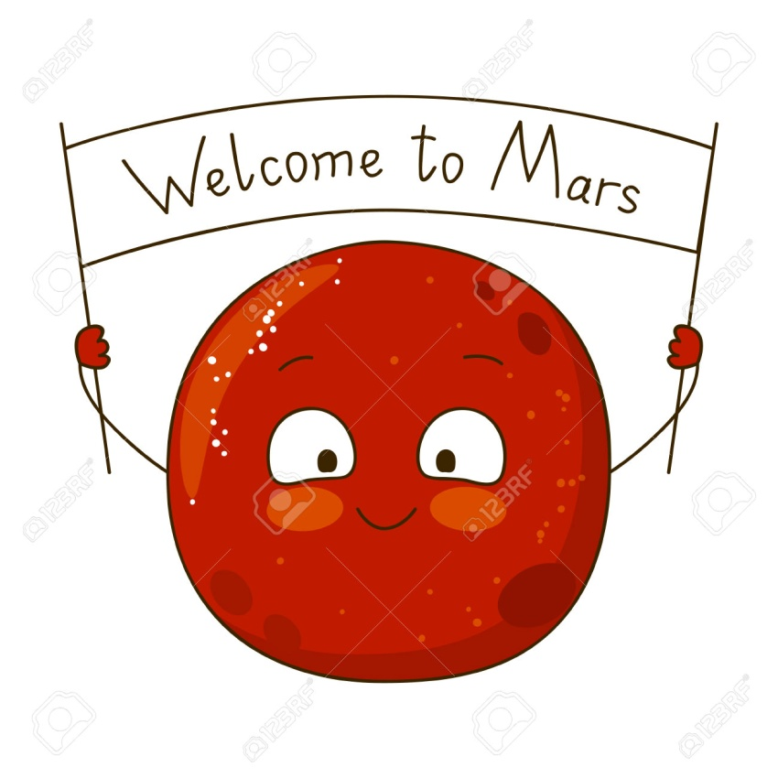
Solving Jet Set Mars challenge.
Use of solar flares as a Power Source
Use of gyroscope for balancing
by-MAIT’IAN

Slide 2
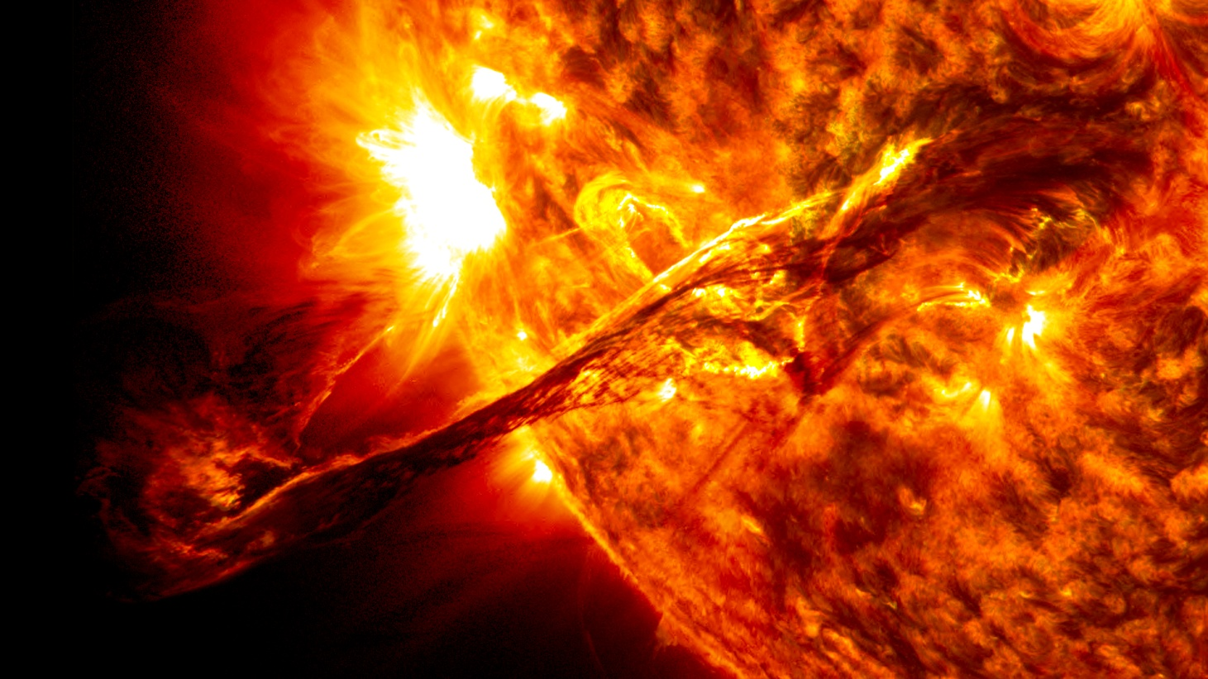
Power Sources ?
Solar
Nuclear
Fuel Cells
Batteries

Slide 3
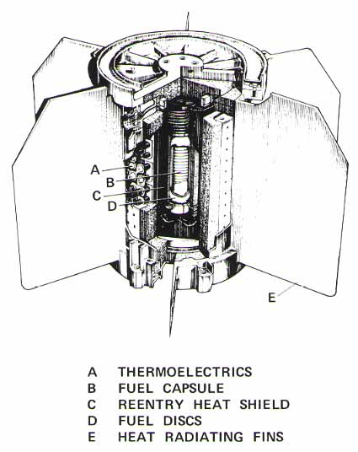
What is RTG’s ?
Typically use plutonium-238 oxide pellets.
Array of Thermocouples converts heat into electrical energy via seedbeck effect.
Units typically produce 100’s of watts for 25 years.

Slide 4
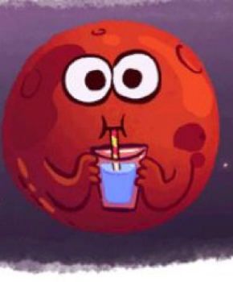
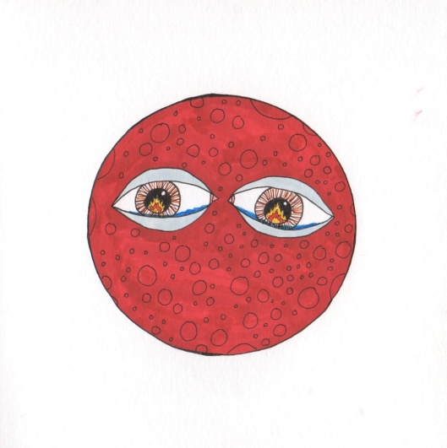
Pro’s and con’s of RTG’s ?
Pro’s :-
Longer life as compared to other sources
More reliable
Maintenance cost is low
End product can be Reused
Con’s :-
Efficiency is too low (5% to 7%)
Fuel used is radioactive
Cannot be used in high temperatures.

Slide 5
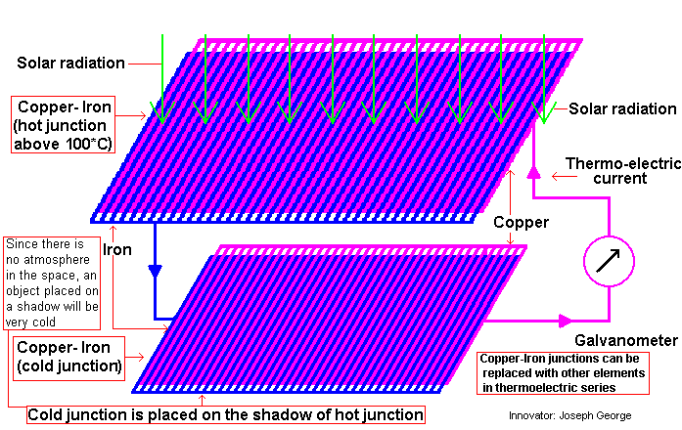
Solution !!
Key ingredients :-
Alpha – particles
Thermocouplers
Magnetic field
Working :-
Focusing of alpha rays using artificial magnetic field.
Rise in temperature of thermocouplers due to the bombardment of particles.
Here seebeck effect comes
And
Volla !!! We’re Done

Slide 6
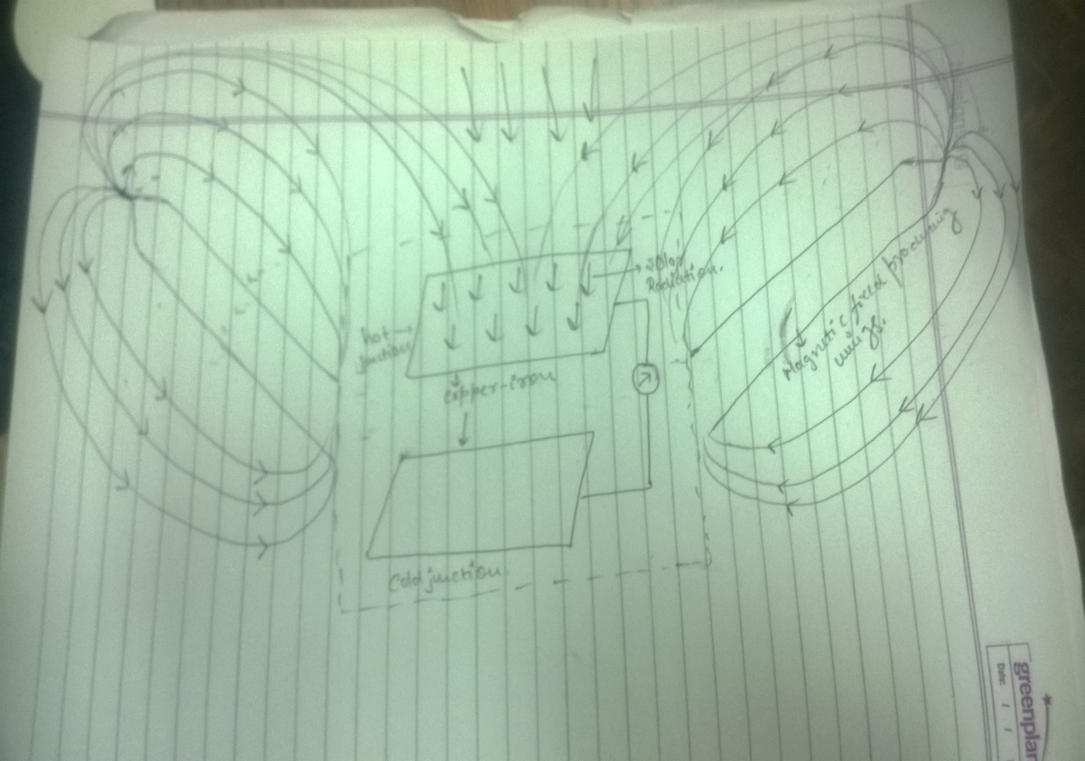
Insight :-
Sun looses billions of kg. of mass every day in form of Radiation
Containing highly charged protons, alpha paticles, helium ions, beta+, beta-, photons, neutrons, electrons etc.
Min. power produced will be atleast 50 watts.
Maintenance cost is very low.
Manufacturing cost will be low.
Wings are foldable.

Slide 7
Solving Jet Set Mars challenge.
Use of gyroscope for balancing.

Slide 8
Problem of balancing with jetpacks.
Jet Packs are a great solution to the mobility problem of astronauts in SPACE!!
But in gravity-less, atmosphere-less environment they can really be a PAIN IN THE BACK. Its really difficult to stabilize ourselves using JETPACKS. Like its difficult to capture smooth elegant pictures in space.
So in THIS presentation we aspire to propose what according to us can be a POTENTIAL solution.
We are inspired by the SPIN STABILIZED SATELLITES technique. But let us first dwell deep into the GYROSCOPES

Slide 9
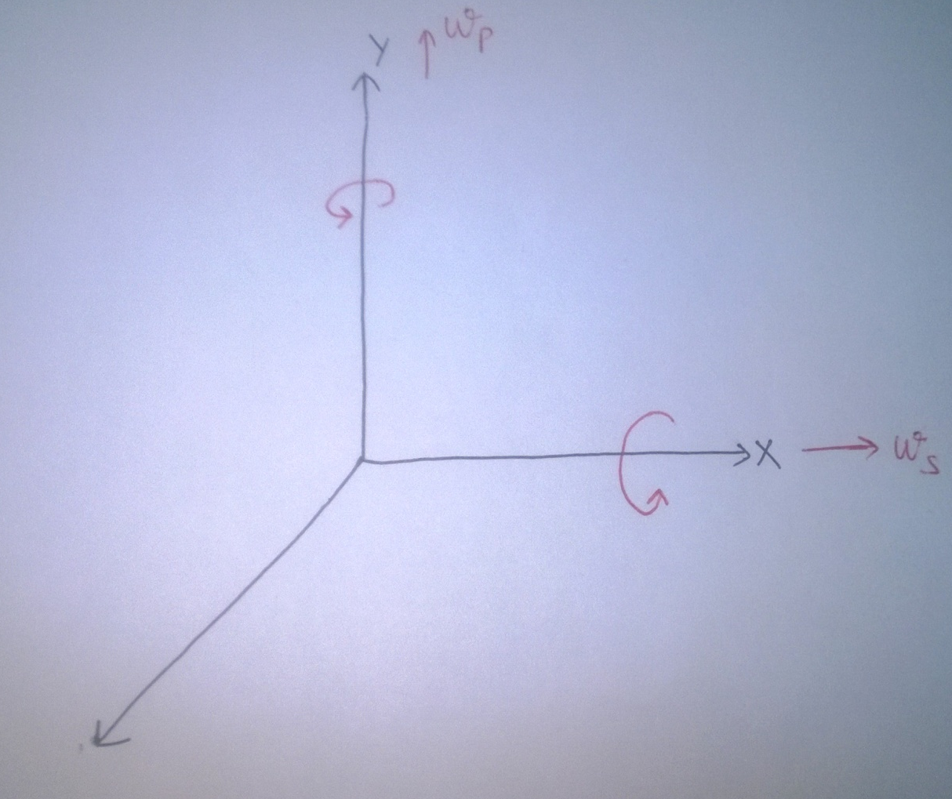
Gyroscopic effect
Let say that body is rotating about its own axis (along the X axis).
Further say it is also revolving about the Y axis.
THEN GYROSCOPIC EFFECT SAYS THAT
The Body will experience a net torque along the Z axis.

Slide 10
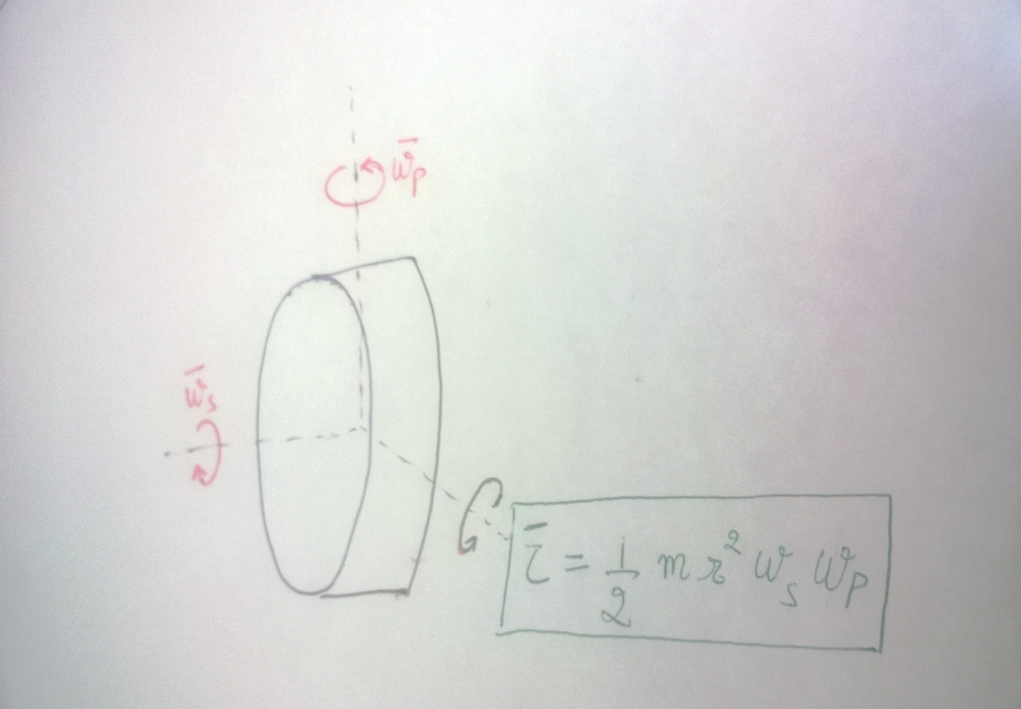
This idea is further illustrated in the following diagram.
Here the red arrows are the applied directions and greenish one is the resultant torque.

Slide 11
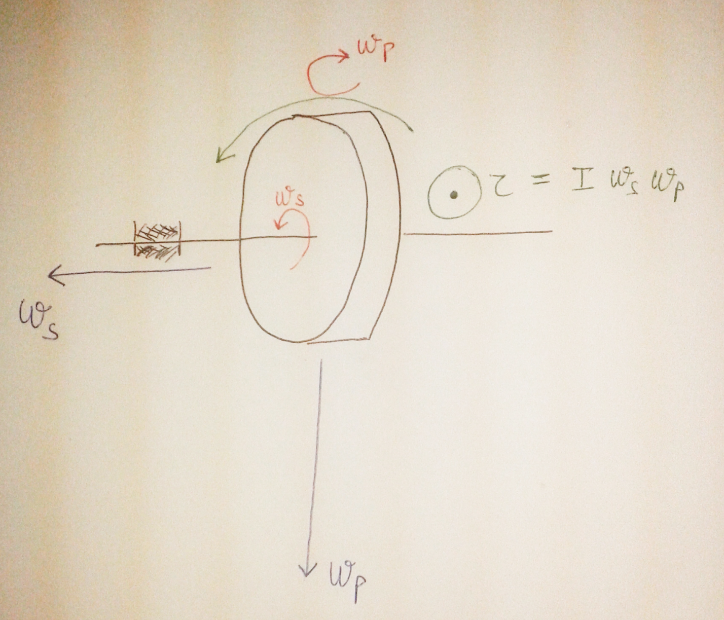
Gyroscope Balancing
Here when the body is not rotating it will try to bend or fall in the right direction as it is hinged on the left.
Howsoever when it starts rotating in the directions indicated by the red arrows, a net torque develops in the direction as shown (green one).
Hence we see torque is preventing it from falling.

Slide 12
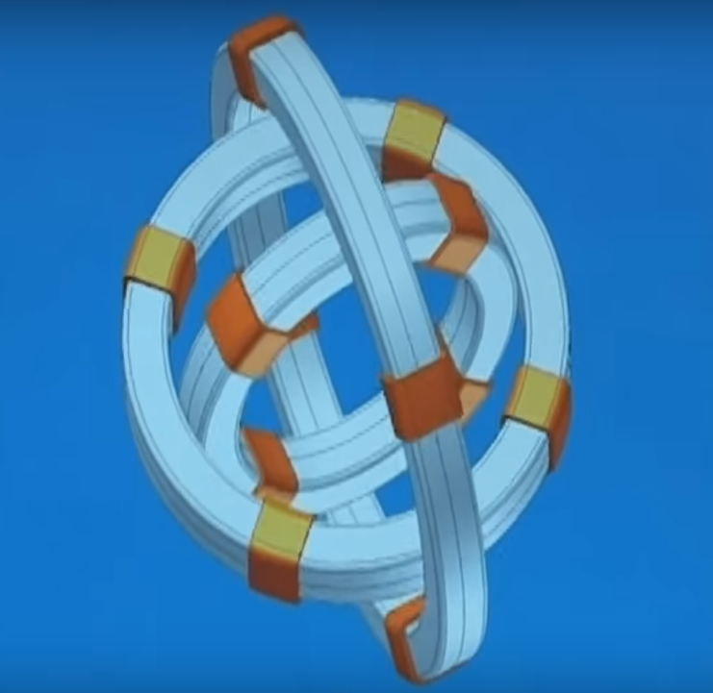
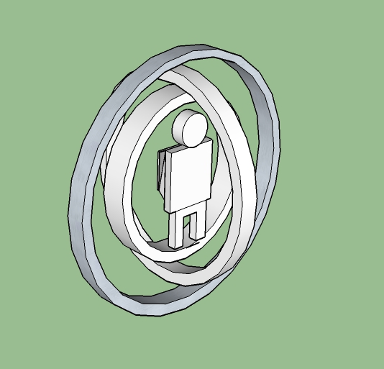
Our Idea
Similarly for balancing in all the direction three gyroscopic rings are used.
We propose to place the man in the middle of the rings aligning the orientation of the gyroscope as the man in the middle desires.

Slide 13
Thank you
by :- Ayush Gupta
Ikjot Singh
Mohit Lamba
Jitendra Kumar Yadav

